Slide 1

Proactive Heating Control With Reinforcement Learning
Jacob Johansson Johan Lindholm Mudar Ibrahim

Slide 2
RL for Proactive heating
Implementing AI instead the traditional approach.
Simple benefits that affect us.
1- Minimizing energy.
2- Reducing costs.
3- Enviormental impact.
4- Automaticlly adjusting.
Notes:
we use advanced AI techniques to optimize heating systems for maximum efficiency and comfort. By employing reinforcement learning algorithms, our system learns from data and interactions to make proactive decisions,
adjusting heating parameters preemptively rather than reactively.
This not only ensures optimal temperature regulation but also minimizes energy consumption, reducing costs and environmental impact.

Slide 3
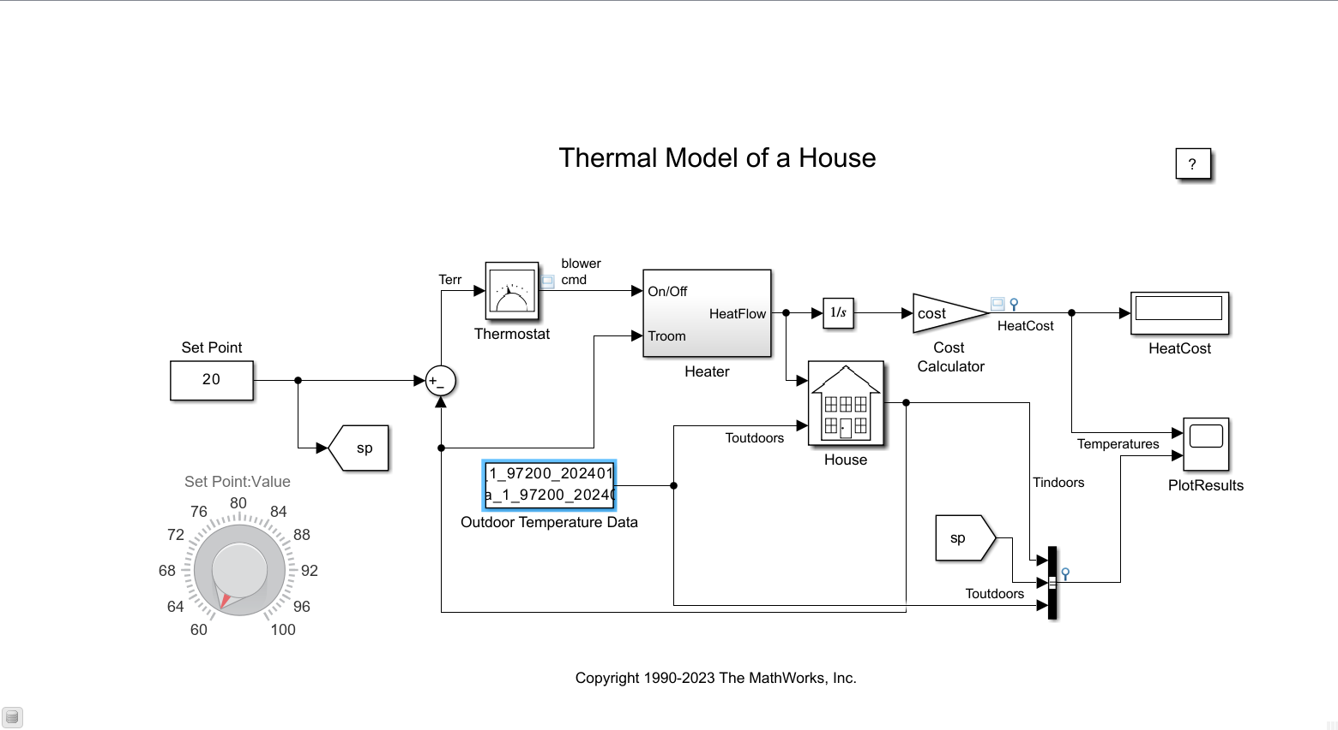
Simulation
MatLAB
Outdoor Temperatures from SMHI

Slide 4
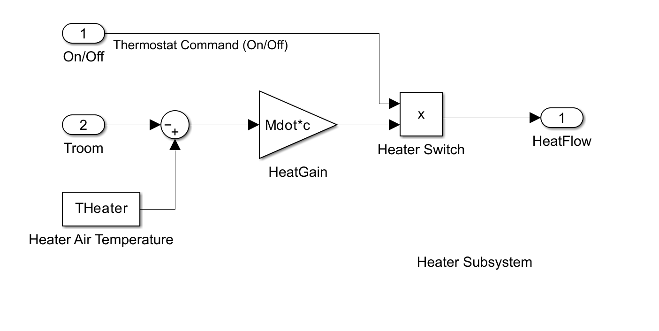

Heater
$$\text{HeatFlow} =\left(THeater−TRoom\right)∗Mdot∗c$$
Mdot: Constant flow rate (1kg /sec)
THeater: Constant heater temperature (50 ◦C)
TRoom: Temperature of the room (◦C)
C: Heat capacity of air at constant pressure (1005.4 J/kg-K)

Slide 5
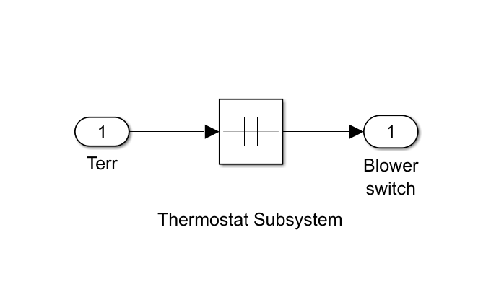

Thermostat - Simulation
$On if TRoom −Deadband<Lower Threshold$
$Off if TRoom −Deadband>Upper Threshold$

Slide 6
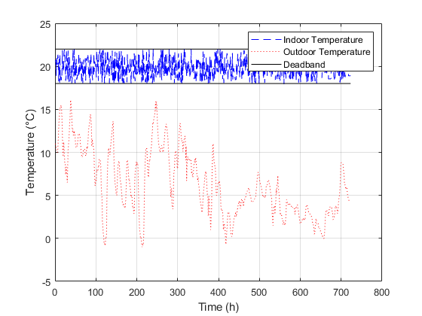
Thermostat - Result
October (31 days)

Slide 7
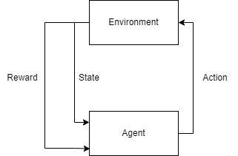
Reinforcement Learning
Q-learning using Epsilon-Greedy algorithm
Notes:
We create and fill a table storing state-action pairs, which is called Q. Depending on how well an action does in a given state, a reward is distributed. Epsilon-greedy algorithm can either explore or be greedy. When exploring, it chooses an action at random, and when exploiting it picks the action with the highest reward. If it explores or exploits is based on the defined variable epsilon.

Slide 8

Reinforcement Learning - Parameters
Learning rate $α=0.5$
Discount factor $γ$ = 0.99
Reward inside interval: $\frac{1}{1+\left|actual−desired\right|}$
Reward outside interval: -100
$Q\left(s,a\right)+= α∗(Reward+γ\max\left(Q\left(s^{′},a′ \right)\right)−Q\left(s,a\right))$

Slide 9
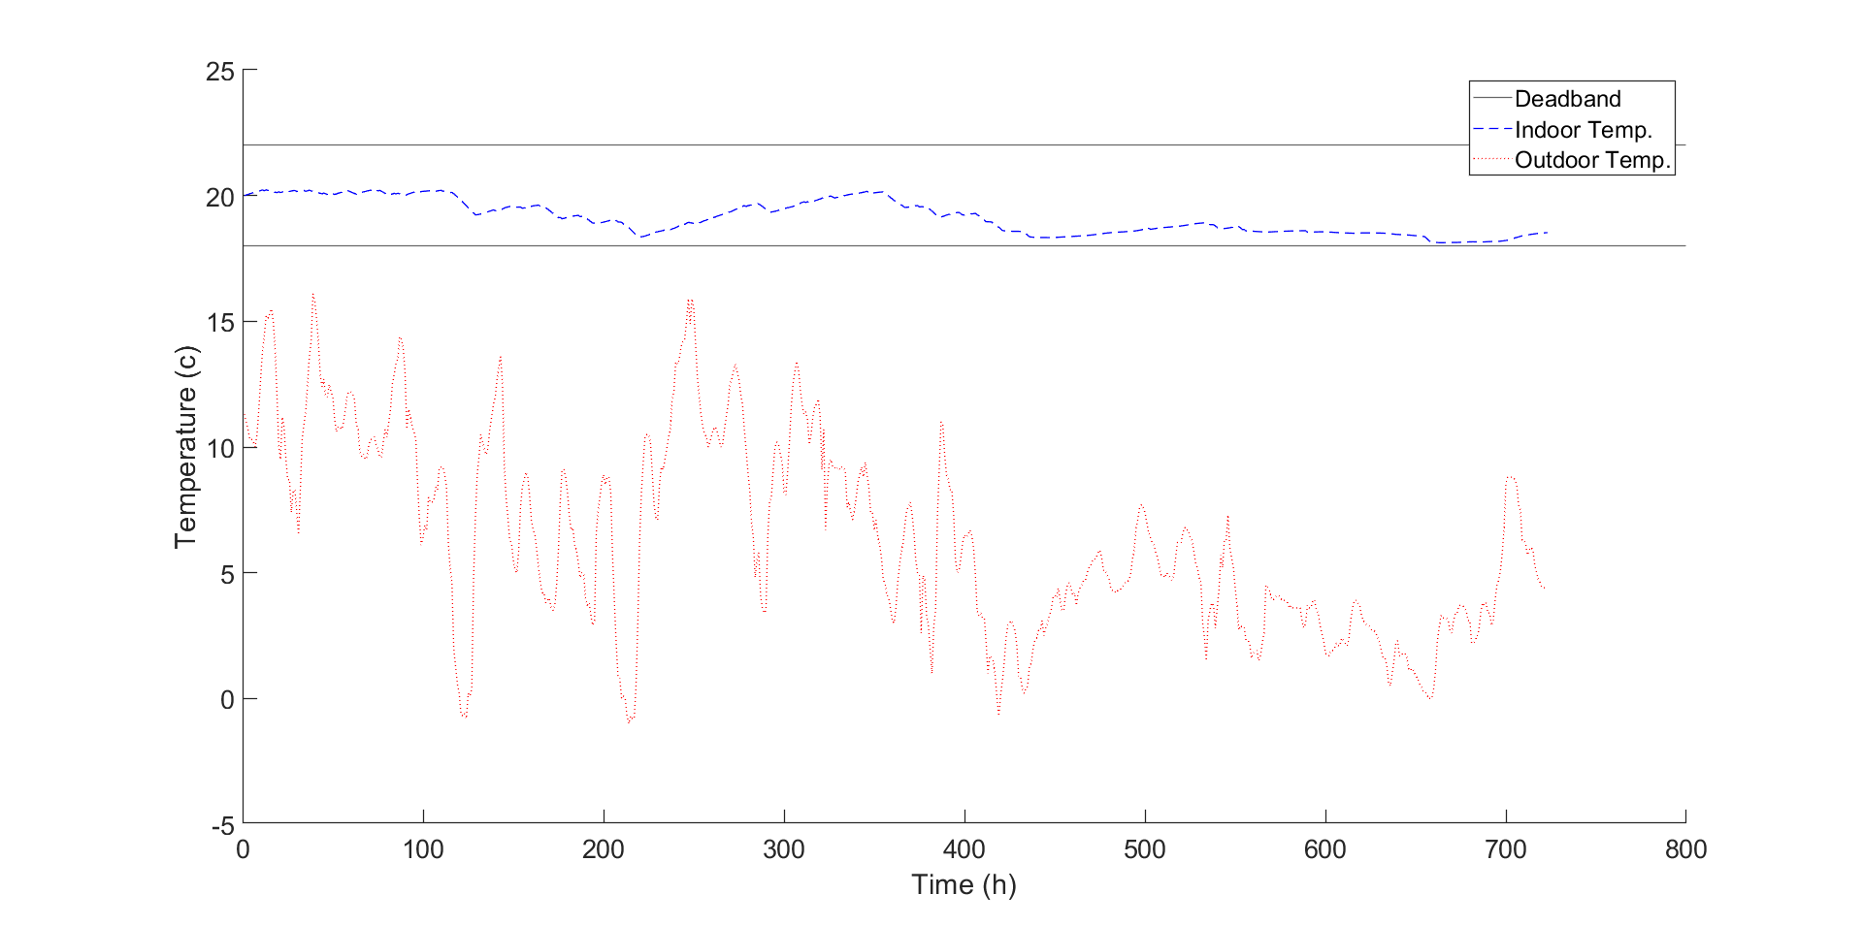
Comparison between Agent and Thermostat
Agent
Thermostat

Slide 10
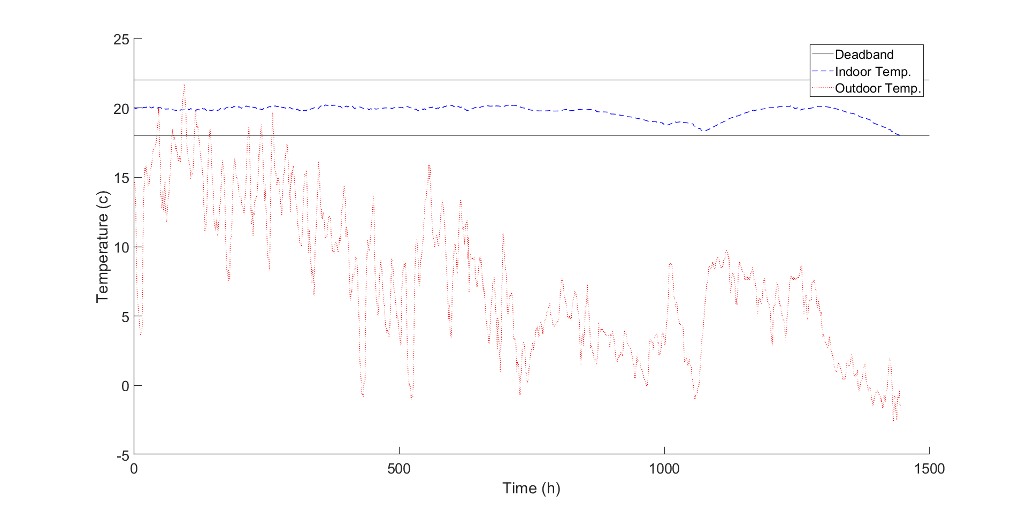
Result

